Slide 1
Yoshida et al, 2019 Ecosystem changes following the eradication of invasive species: Evaluation of various eradication scenarios by computer simulation https://doi.org/10.1016/j.ecolmodel.2019.108831.

Slide 2
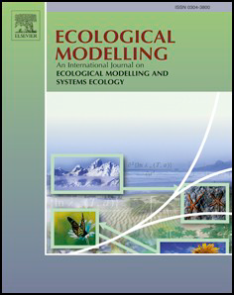
What journal is the article published in?
Ecological Modelling, an International Journal on Ecological and Systems Modelling
What type of journal is this, and how might it have shaped the paper?
Journals edited by professors in field
Calls for submissions
SJR index: #12/40 in field of Ecological Modelling
H Index: #2/40 in field
Is it focused on ecology, applied ecology, conservation, mathematical modelling, etc.
Yes

Slide 3
What ecological problem is the paper addressing?
Predicting the effects of eradicating goats and rats on Nakoudojima Island, part of Ogasawara Islands, Japan
Post eradication effects
Describe the real-world ecological issue or system that the study is concerned with.

Slide 4
What ecological problem is the paper addressing?
Predicting the effects of eradicating goats and rats on Nakoudojima Island, part of Ogasawara Islands, Japan
Post eradication effects
Describe the real-world ecological issue or system that the study is concerned with.
Goats eradicated in a program 20 years ago. Is the current situation predictable based on their approach?

Slide 5
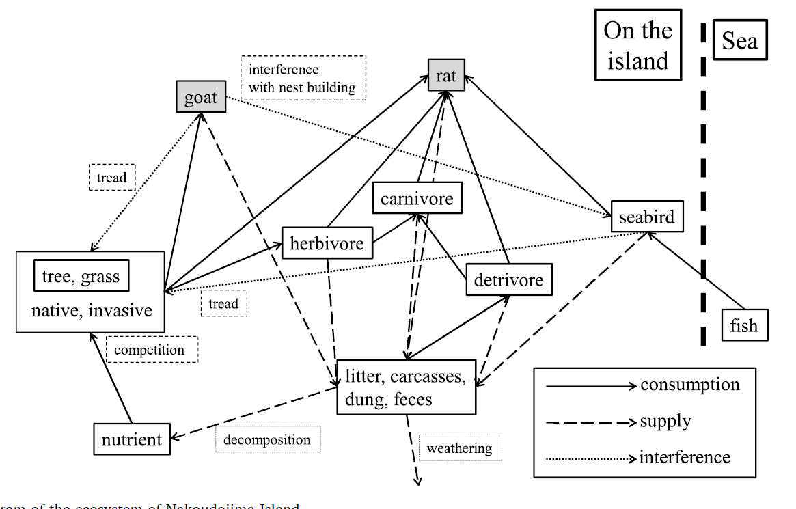
What specific knowledge gap is this paper filling?
Paper says previous articles, mostly, don’t consider material cycles
Identify what was not previously known or understood before this paper was published.
Does it resolve an unanswered question, challenge an existing idea, extend a previous approach to a new system?

Slide 6
What specific knowledge gap is this paper filling?
Paper says previous articles, mostly, don’t consider material cycles
Identify what was not previously known or understood before this paper was published.
Paper says eradicating goats+rats at same time is best, but, that leads to extreme results. Either the entire island forested or total loss of forest.
Does it resolve an unanswered question, challenge an existing idea, extend a previous approach to a new system?

Slide 7
What specific knowledge gap is this paper filling?
Paper says previous articles, mostly, don’t consider material cycles
Identify what was not previously known or understood before this paper was published.
Paper says eradicating goats+rats at same time is best, but, that leads to extreme results. Either the entire island forested or total loss of forest.
Does it resolve an unanswered question, challenge an existing idea, extend a previous approach to a new system?
The conclusion is that eradication alone isn’t enough. Eradication can lead to extreme and surprising results. Post monitoring is necessary

Slide 8
What mathematical methods are used?
No community matrix, no model provided. Supplementary information carries details about individual calculations, but no overall system provided. No code provided.
Give a general description of the mathematical or modelling techniques applied in the paper (if any).
Do the authors make the case that these methods are appropriate for the problem they are studying?

Slide 9
What mathematical methods are used?
No community matrix, no model provided. Supplementary information carries details about individual calculations, but no overall system provided. No code provided.
Give a general description of the mathematical or modelling techniques applied in the paper (if any).
Goats removed by set amount of biomass per day. This doesn’t match the actual removal (intermittently over one year).
Do the authors make the case that these methods are appropriate for the problem they are studying?

Slide 10
What mathematical methods are used?
No community matrix, no model provided. Supplementary information carries details about individual calculations, but no overall system provided. No code provided.
Give a general description of the mathematical or modelling techniques applied in the paper (if any).
Goats removed by set amount of biomass per day. This doesn’t match the actual removal (intermittently over one year).
Rats removed according to an equation, not total eradication. This mirrors reality where rats are hard to find and catch, so eradication is hard.
Do the authors make the case that these methods are appropriate for the problem they are studying?

Slide 11
What mathematical methods are used?
No community matrix, no model provided. Supplementary information carries details about individual calculations, but no overall system provided. No code provided.
Give a general description of the mathematical or modelling techniques applied in the paper (if any).
Goats removed by set amount of biomass per day. This doesn’t match the actual removal (intermittently over one year).
Rats removed according to an equation, not total eradication. This mirrors reality where rats are hard to find and catch, so eradication is hard.
Table AM.4 is a list of assimilation rates, and that explains that a uniform distribution was used. This confirms use of stochastic simulation.
Do the authors make the case that these methods are appropriate for the problem they are studying?

Slide 12
What mathematical methods are used?
No community matrix, no model provided. Supplementary information carries details about individual calculations, but no overall system provided. No code provided.
Give a general description of the mathematical or modelling techniques applied in the paper (if any).
Goats removed by set amount of biomass per day. This doesn’t match the actual removal (intermittently over one year).
Rats removed according to an equation, not total eradication. This mirrors reality where rats are hard to find and catch, so eradication is hard.
Table AM.4 is a list of assimilation rates, and that explains that a uniform distribution was used. This confirms use of stochastic simulation.
1000 simulations for each scenario for eradication of 1) rats, 2) goats, 3) rats and goats. Results combined into histograms with data spread reported to show wide variety of outcomes
Do the authors make the case that these methods are appropriate for the problem they are studying?

Slide 13
What mathematical methods are used?
No community matrix, no model provided. Supplementary information carries details about individual calculations, but no overall system provided. No code provided.
Give a general description of the mathematical or modelling techniques applied in the paper (if any).
Goats removed by set amount of biomass per day. This doesn’t match the actual removal (intermittently over one year).
Rats removed according to an equation, not total eradication. This mirrors reality where rats are hard to find and catch, so eradication is hard.
Table AM.4 is a list of assimilation rates, and that explains that a uniform distribution was used. This confirms use of stochastic simulation.
1000 simulations for each scenario for eradication of 1) rats, 2) goats, 3) rats and goats. Results combined into histograms with data spread reported to show wide variety of outcomes
Do the authors make the case that these methods are appropriate for the problem they are studying?
Yes

Slide 14
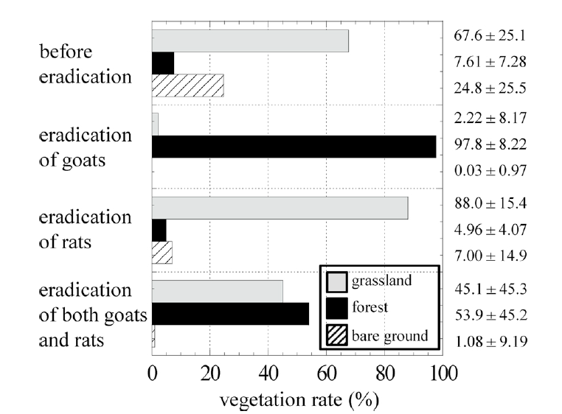
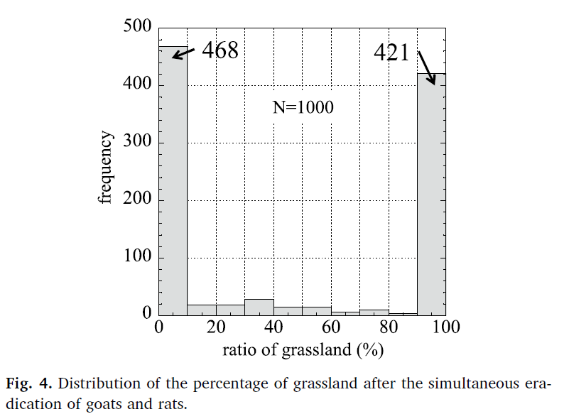
What are the key results and recommendations? Summarise the main findings of the paper.
Wild variation in outcomes for vegetation when rats and goats are both removed.
Do the results confirm or contradict previous studies?
What recommendations do the authors make for ecological management, conservation, or further research?
How does this paper relate to our project?

Slide 15
What are the key results and recommendations? Summarise the main findings of the paper.
Wild variation in outcomes for vegetation when rats and goats are both removed.
Despite this, eradication of goats and rats is the preferred option.
Do the results confirm or contradict previous studies?
What recommendations do the authors make for ecological management, conservation, or further research?
How does this paper relate to our project?

Slide 16
What are the key results and recommendations? Summarise the main findings of the paper.
Wild variation in outcomes for vegetation when rats and goats are both removed.
Despite this, eradication of goats and rats is the preferred option.
After the eradication program 20 years ago (of goats and not rats), only some forest returned. This contradicts the model’s predictions. Soil erosion was a factor in the slow growth of trees.
Do the results confirm or contradict previous studies?
What recommendations do the authors make for ecological management, conservation, or further research?
How does this paper relate to our project?

Slide 17
What are the key results and recommendations? Summarise the main findings of the paper.
Wild variation in outcomes for vegetation when rats and goats are both removed.
Despite this, eradication of goats and rats is the preferred option.
After the eradication program 20 years ago (of goats and not rats), only some forest returned. This contradicts the model’s predictions. Soil erosion was a factor in the slow growth of trees.
Do the results confirm or contradict previous studies?
Not clear from reading this paper.
What recommendations do the authors make for ecological management, conservation, or further research?
How does this paper relate to our project?

Slide 18
What are the key results and recommendations? Summarise the main findings of the paper.
Wild variation in outcomes for vegetation when rats and goats are both removed.
Despite this, eradication of goats and rats is the preferred option.
After the eradication program 20 years ago (of goats and not rats), only some forest returned. This contradicts the model’s predictions. Soil erosion was a factor in the slow growth of trees.
Do the results confirm or contradict previous studies?
Not clear from reading this paper.
What recommendations do the authors make for ecological management, conservation, or further research?
Since eradication of both goats and rats is preferred, and since that can lead to unpredictable results for vegetation, then post- eradication monitoring is needed. Post adaptive changes can be made as needed.
How does this paper relate to our project?

Slide 19
What are the key results and recommendations? Summarise the main findings of the paper.
Wild variation in outcomes for vegetation when rats and goats are both removed.
Despite this, eradication of goats and rats is the preferred option.
After the eradication program 20 years ago (of goats and not rats), only some forest returned. This contradicts the model’s predictions. Soil erosion was a factor in the slow growth of trees.
Do the results confirm or contradict previous studies?
Not clear from reading this paper.
What recommendations do the authors make for ecological management, conservation, or further research?
Since eradication of both goats and rats is preferred, and since that can lead to unpredictable results for vegetation, then post- eradication monitoring is needed. Post adaptive changes can be made as needed.
How does this paper relate to our project?
Some simulations had ecosystems crash. These are considered perturbations that are strong enough for a regime shift, according to the authors.

